Slide 1
31/07/2019
Supermarket
Group No.05:-X-MEN
Sameer Shaik(14446)
Shrikant Gautam(14443)
Saikiran Kota(14445)
Sanyogita Dere(14433)

Slide 2
Introduction
Supermarket is an useful application where users can buy products.
Our application consists of three modules which are user module, admin module and login module.
Login module provides role based authentication.
User can search for a product and then user can add products to cart.
Admin can add, delete and update products.

Slide 3
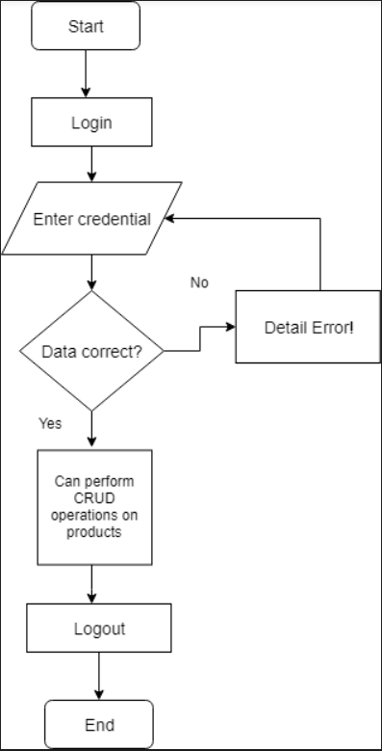
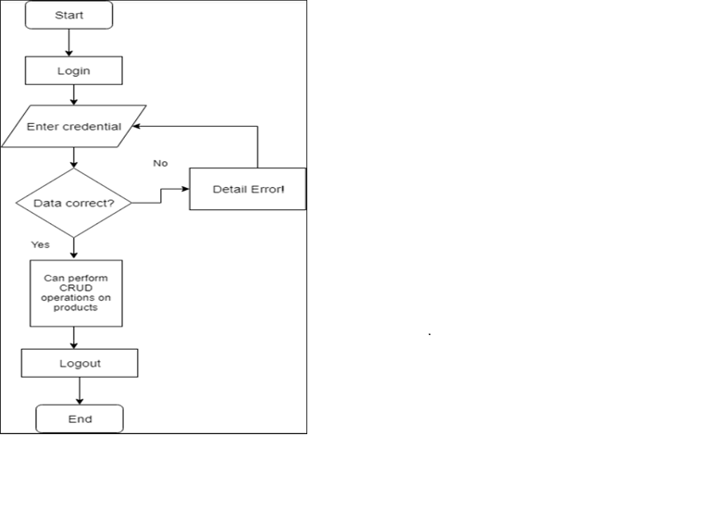
Flowchart
ADMIN_ROLE

Slide 4
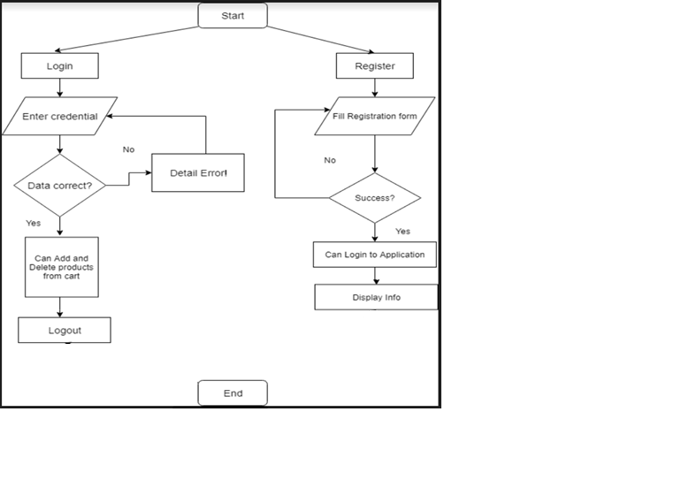
Flowchart
USER_ROLE

Slide 5
Technology
Frontend | Backend
Angular- Created components and services. | Spring Boot- Backend is implemented using spring boot.
HTML5- Designing webpages | Maven- Build tools to insert dependencies
CSS3- Styling of webpages. | Hibernate- Object relational mapping framework.
Bootstrap – To make webpage responsive. | MySQL- Managing data.

Slide 6
Innovation and Business
features
We provide authentication and role based authorization.
Admin can activate or inactivate a product depending whether the product is in stock or not.
Users can search a product by using product name.
There is complete transparency between Admin and User.
User will be unable to add an out of stock product to the cart.

Slide 7
Problems faced
Problems faced | Solutions
Errors in fetching data-unauthorized access. | Provided http interceptor in app.module.ts.
Problem faced in linking angular with spring boot- cors origins. | Provided WebMvcConfigurer class in main class of spring boot
Role based authentication was not functioning. | Added the required parameters.
Problem faced while integrating different components. | Consolidated with the mentors and rectified the approach.

